Slide 1
Home Credit Risk Analysis
By Vishwa Vijay Pratap Singh,
Vishwas Huligowda,Vishal Garg

Slide 2
Problem Statement
As a business analyst for Home Credit, need to develop a credit scoring mechanism using applicant and bureau data. The goal is to assist Home Credit in making informed decisions on loan approvals based on past applicant behavior and application information. This involves cleaning the data, aggregating trade-level bureau information to the applicant level, creating manual features, and building a classification model to differentiate between approved and rejected applications.
Key Questions involved:
How can trade-level information from credit bureaus be aggregated to the applicant level to capture payment behavior?
What application or payment behavior factors significantly influence a borrower's behavior on a new loan?
How can these factors be leveraged to build a model for decision-making?
Once the model is built, how can its output be translated into strategies and business insights for the bank?

Slide 3
Analysis Strategies
We will follow following Major Steps in solving this problem :
Data Exploration of Application Data
Data Quality Checks and Corrections : Null, Duplicate , missing values and imputation or drop
EDA - Application Data Features ( Univariate / Bivariate - Numerical /Categorical data analysis)
Data Exploration of Bureau Data & Data Quality
Merging of Application data and Bureau data
Feature Engineering - Bureau Data ( Extracting Manual Features )
Feature Selection using ANOVA F value
Data Pre-processing for Machine Learning Model Building ( Label encoding, train_test split,StandardScaler )
Classification Model Building and Model Evaluation alongside :
LogisticRegression
Logistic Regression with Hyper Parameter Tuning
RandomForestClassifier for Binary Classification with Hyper Parameter Tuning
Light Gradient Descent Boosting with Hyperparameter tuning
Conclusion / Recommendation as a Business Analysis to Finance Institutions based on application and Bureau trade level information.

Slide 4
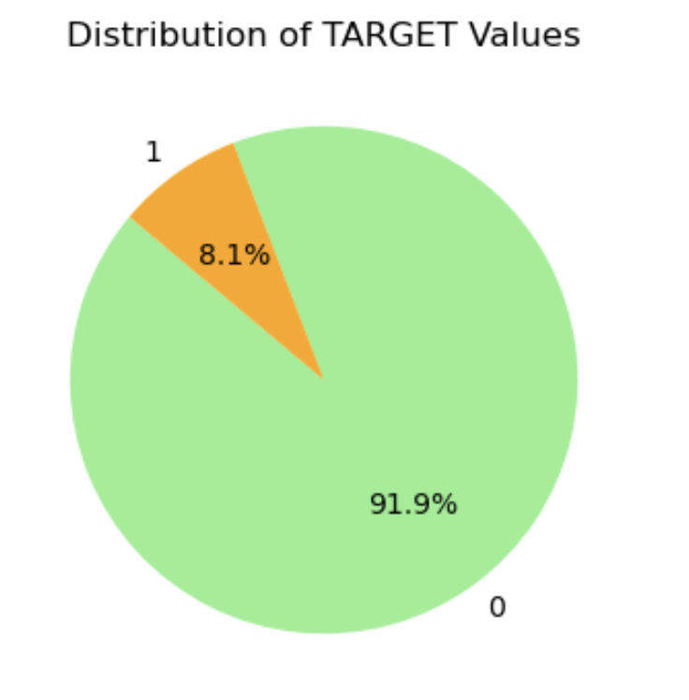
Exploratory data analysis on application data
We performed various data quality checks and run EDA on application data. One of the important aspect is Distribution of TARGET variable
Inference: The data is highly imbalanced, where 91.9% of 'TARGET' variable is 0 (other cases/able to pay loan) and 8.1% of 'TARGET' variable is 1(difficulty in repaying the loan).

Slide 5
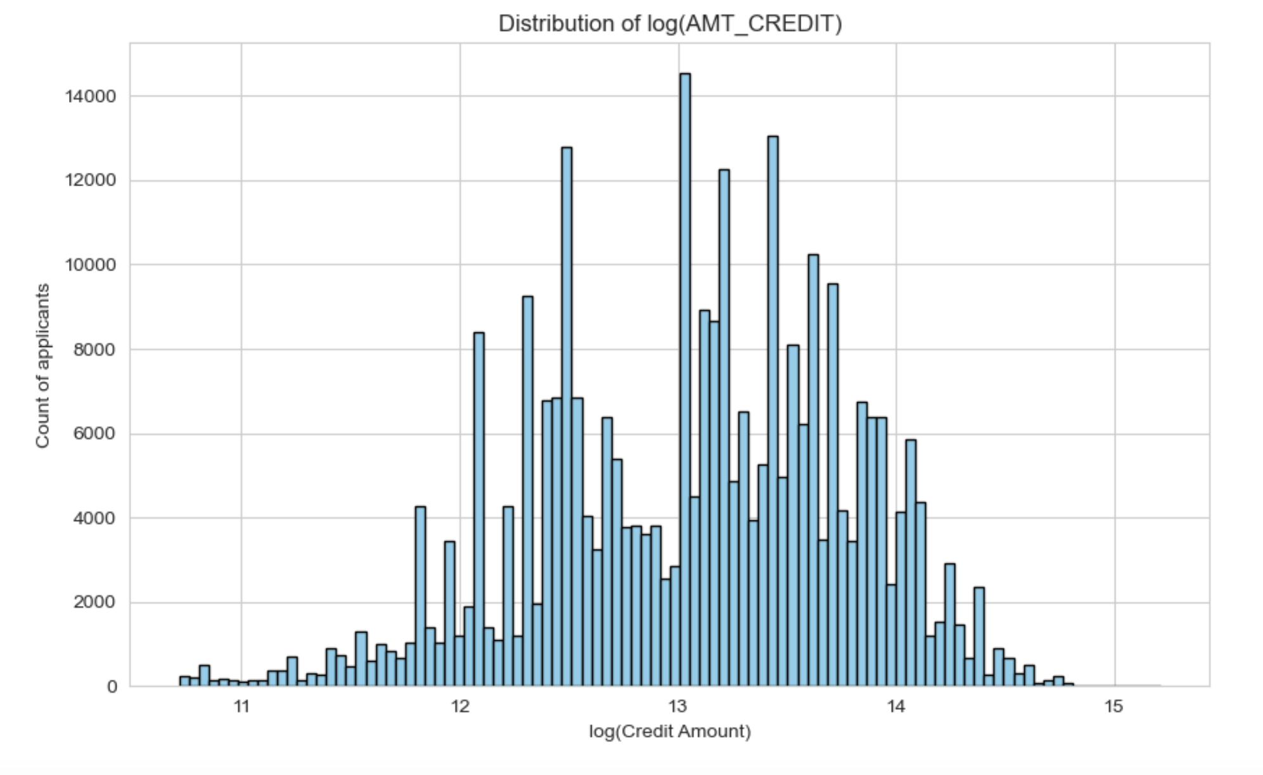
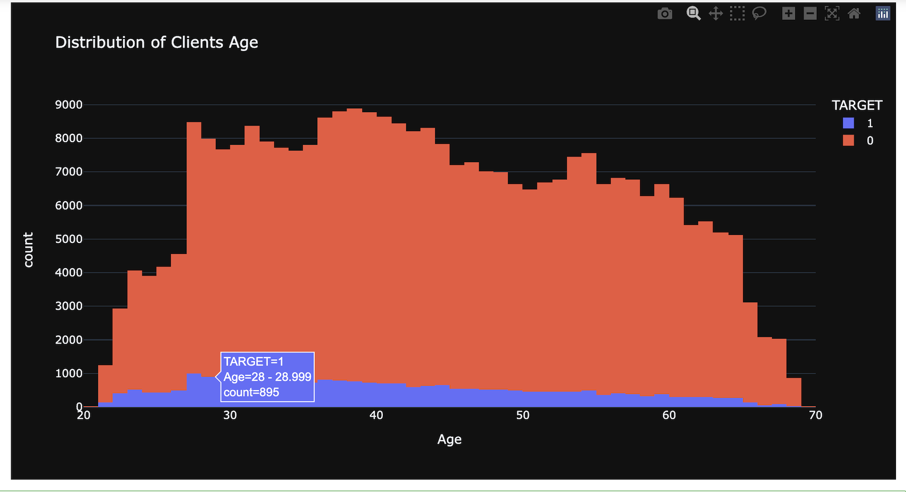
Exploratory data analysis on application data
We performed univariate and bivariate analysis on various numerical and categorical fields Amt Credit and Age Groups seems to be important factor for borrowers behaviour.
Inferences: People who are taking credit for large amount are very likely to repay the loan.
Inference: From the above plot when we compare the two target types, we see that the clients who have difficulty in payment are relatively younger and most of them lie at around 30's.

Slide 6
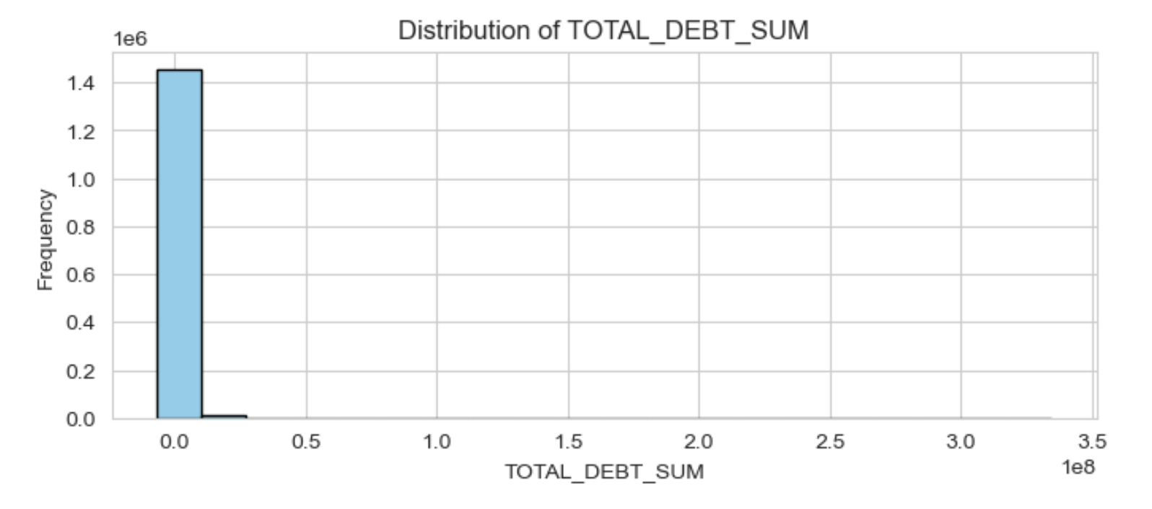
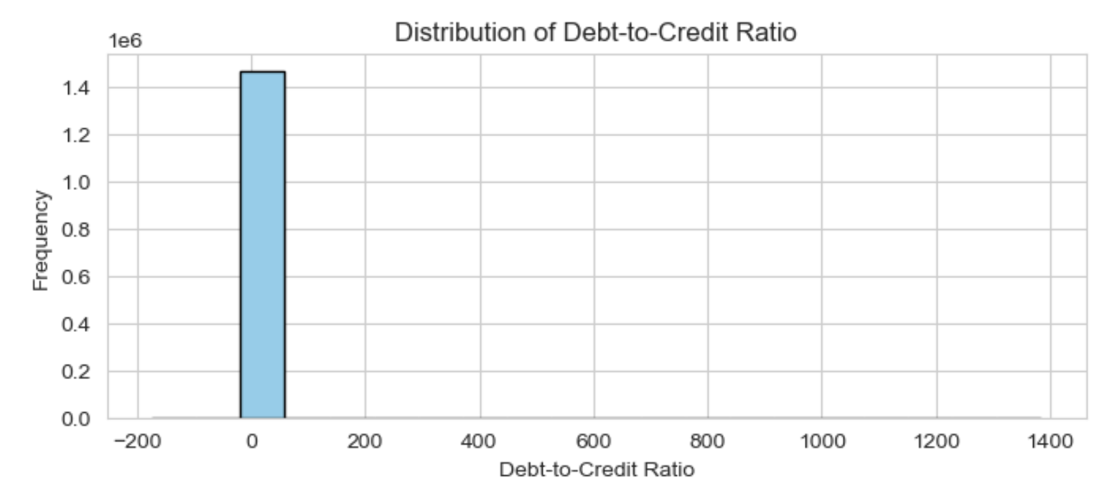
Feature engineering on bureau data
Lets derive the feature name, TOTAL_DEBT_SUM and DEBT_TO_CREDIT_RATIO
Inferences: High frequency at the lower end of the scale in both the feature indicating ,individual have no or very low outstanding debt and recent credit updated or absence of the data set. It will very helpful for better understand the borrowers' credit behavior.

Slide 7
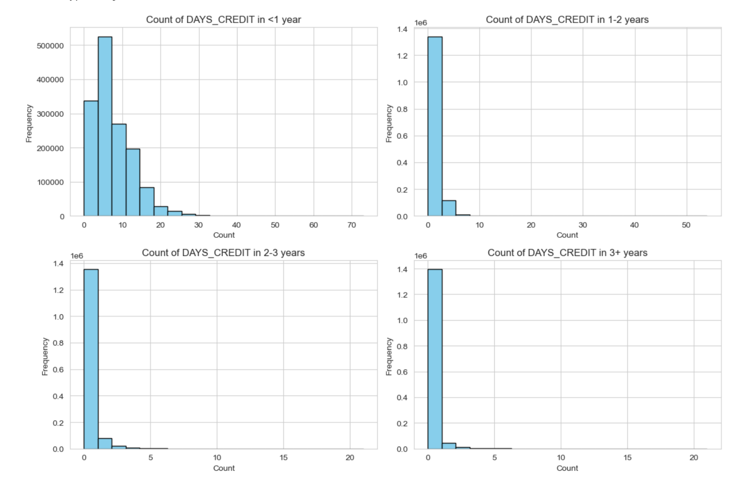
Feature engineering on bureau data
Lets derive the feature from the days _credit_interval for <1 years, 1-2 year,2-3 years and 3+years
Inferences:A high frequency of credit intervals in <1 year indicating ongoing credit enquiries where, a high frequency at the lower end of other time intervals indicates credit inquiries in those intervals are concentrated more towards the recent past than further back in time.

Slide 8
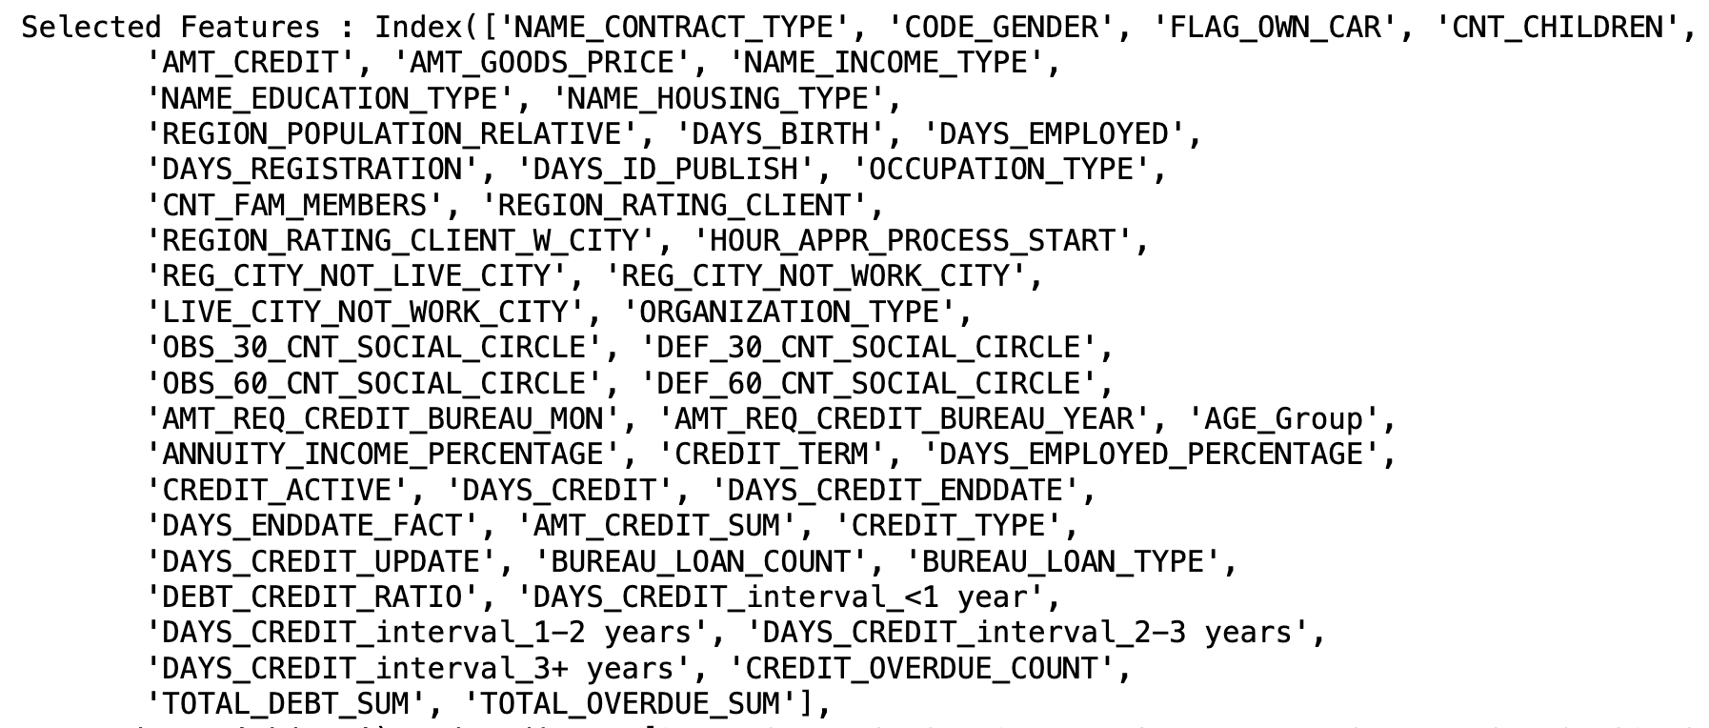
Feature Selection using ANOVA F value
Essentials for enhancing the model accuracy and efficiency. It measures the differences between mean between groups. High value of ANOVA F value indicates the significant predictors.
Using Feature selection in merged - Application and Bureau data , we selected 50 features from 76 features.

Slide 9
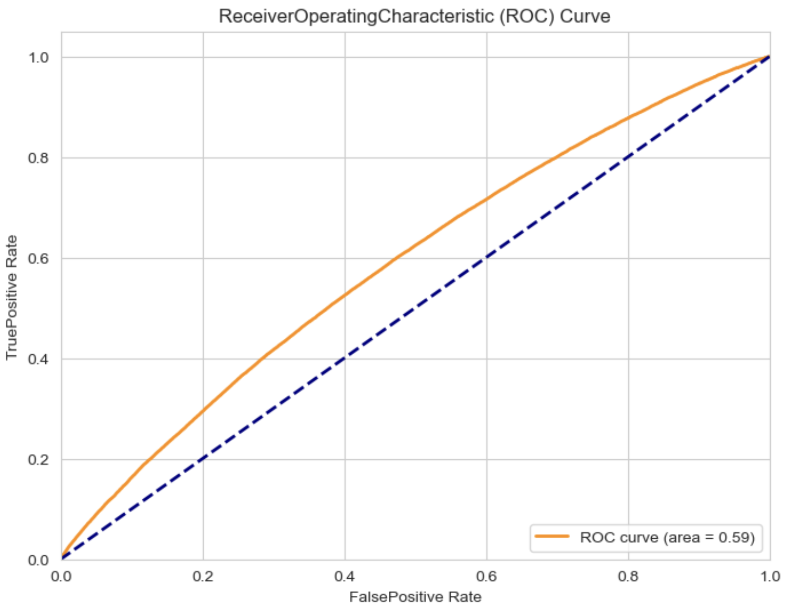
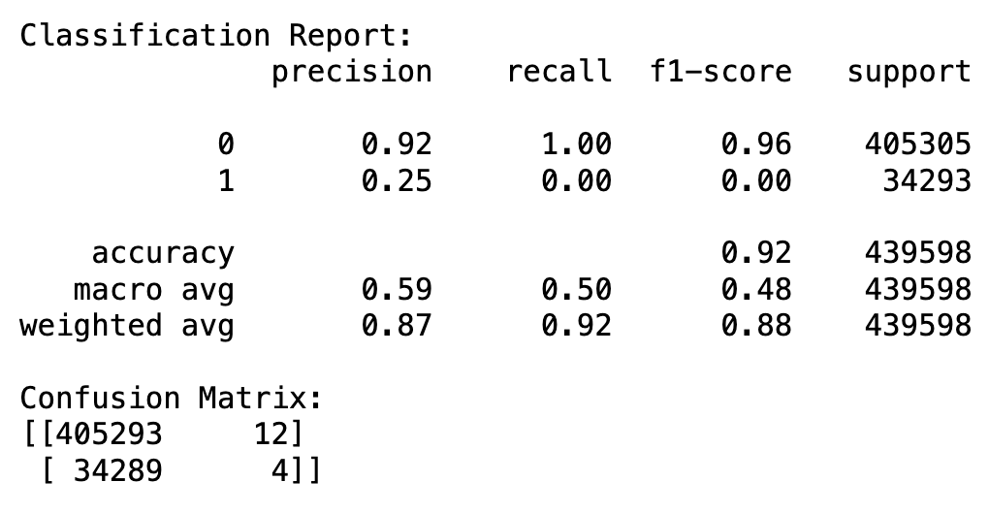
ML Model Building and Model Validation - Logistic Regression
Inference: Looking at the classification report and confusion matrix, we can see that the model's performance is skewed towards the majority class (class 0). Model is unable to correctly identify most of the positive instances. Hence let's build Binary classification logistic regression model with Random Over Sampler.

Slide 10
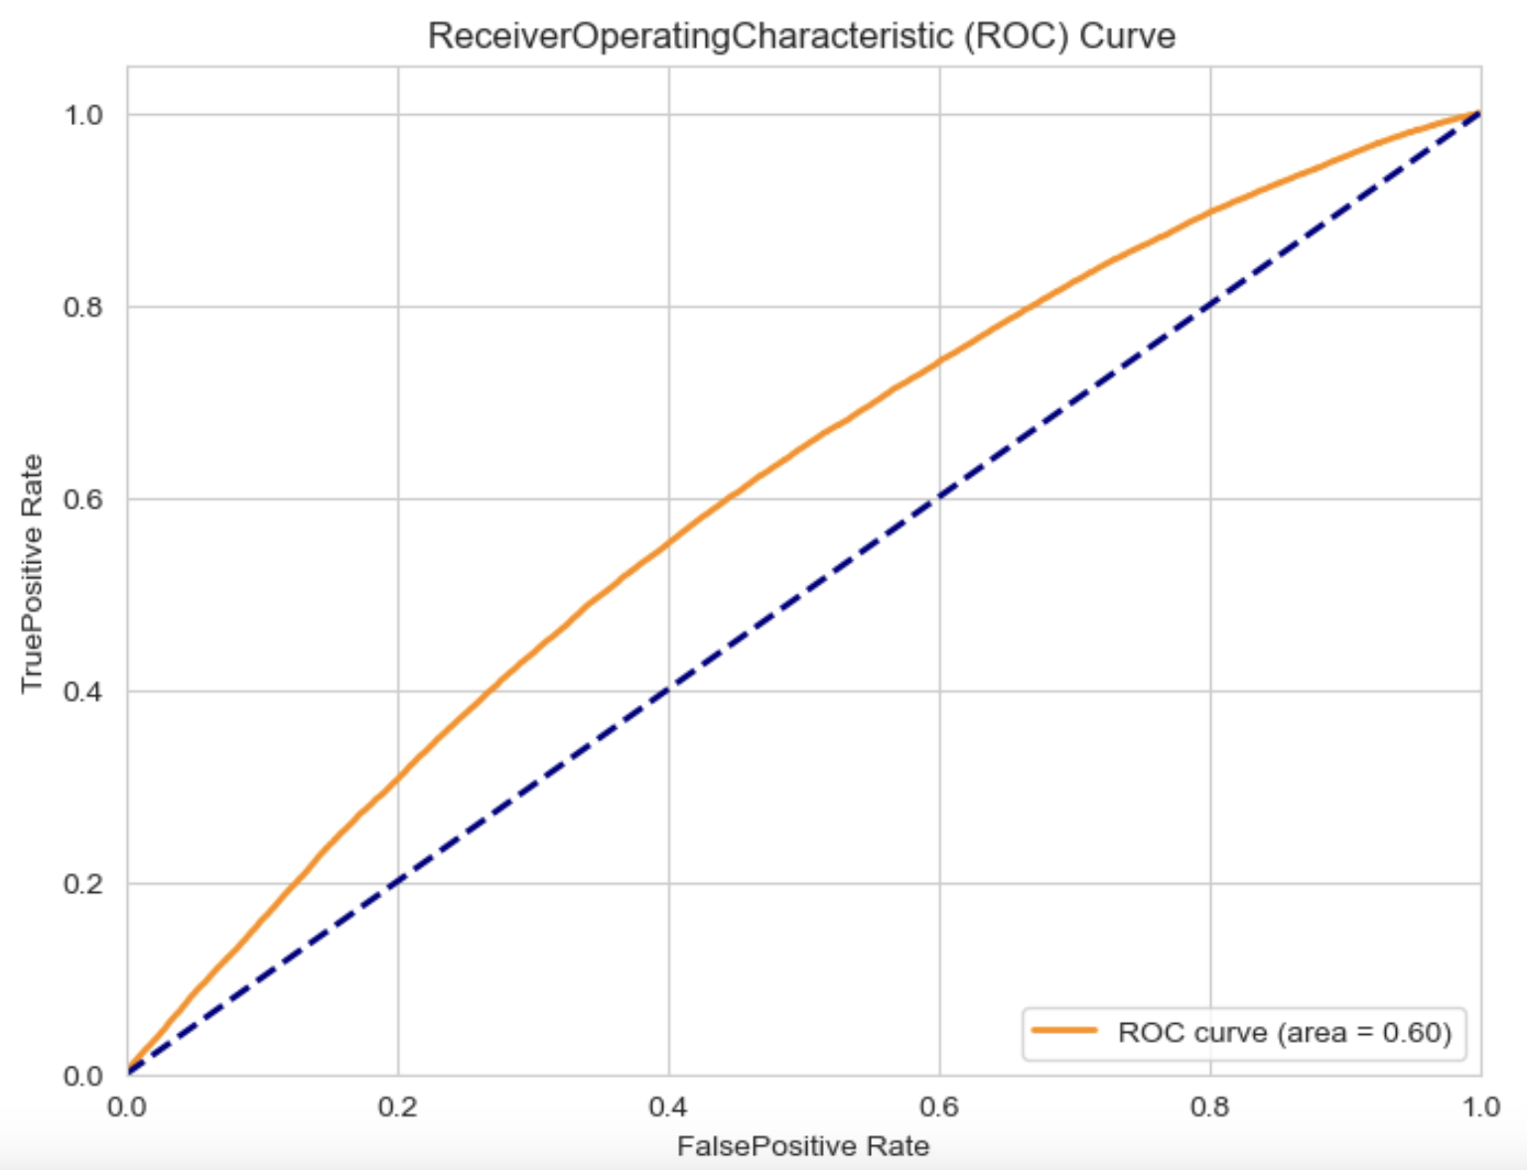
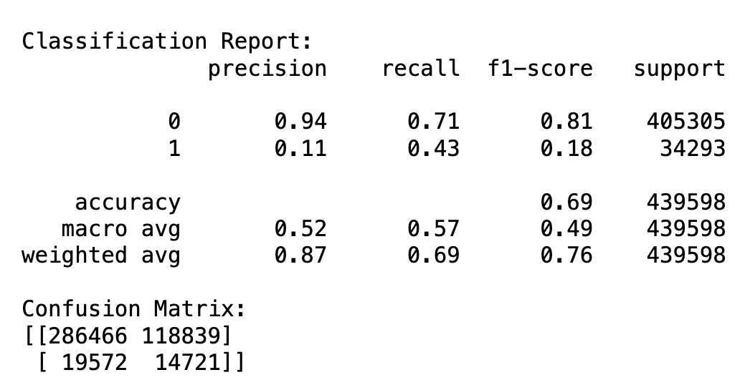
ML Model Building and Model Validation - Logistic Regression with OverSampler
Inference: We can still see that model performance is still poor and Precision for Class-1 is 11%. Though RoC is better i.e 0.60 Hence, let's build binary classification model with RandomForestClassifier HyperParameters tuning

Slide 11
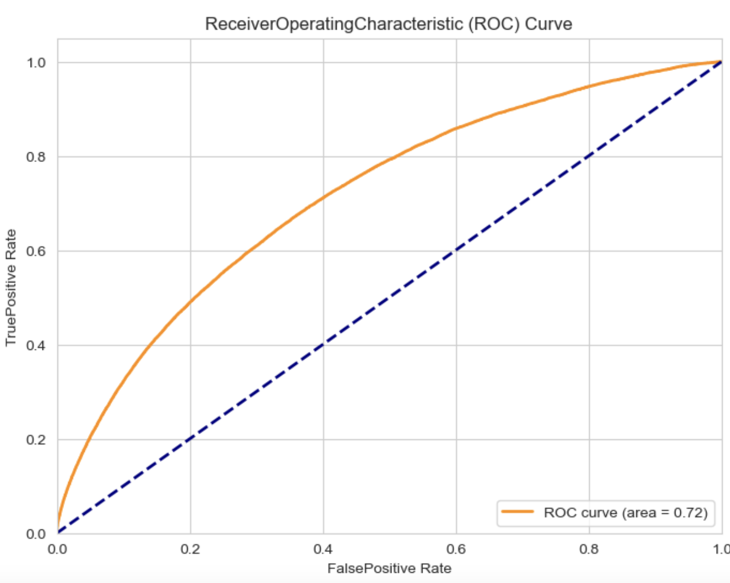
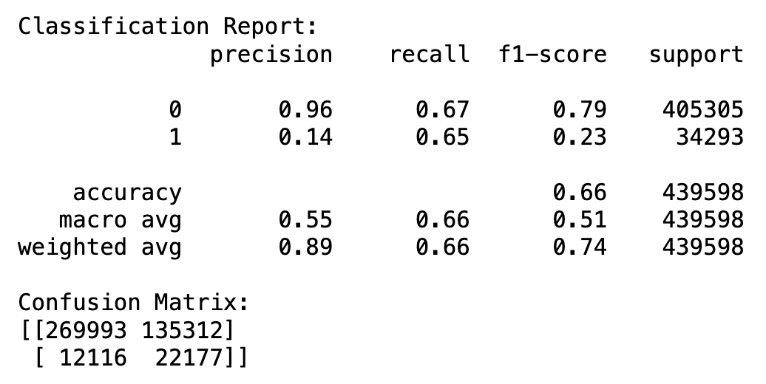
ML Model Building and Model Validation - RandomForestClassifier
Inference: High Precision for Loan Approvals: The model exhibits a high precision rate of 96% for loan approvals, minimizing the risk of granting loans to unqualified applicants. Balanced F1-score for Loan Approvals: With an F1-score of 74% , the model achieves a good balance between precision and recall for approved loans, ensuring reliable decision-making.he ROC curve area of 0.72 demonstrates the model's moderate ability to discriminate between loan approvals and rejections, providing valuable insights for risk assessment.

Slide 12
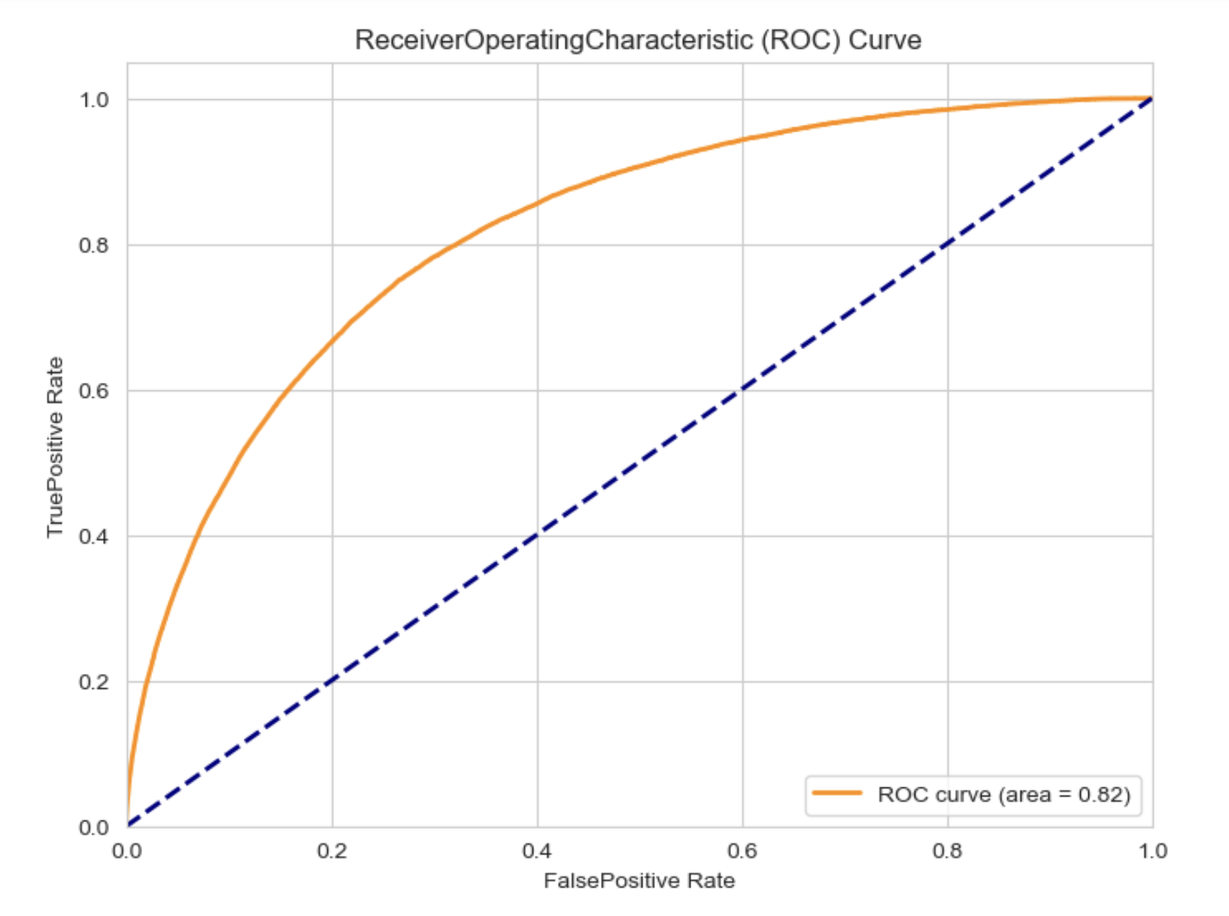
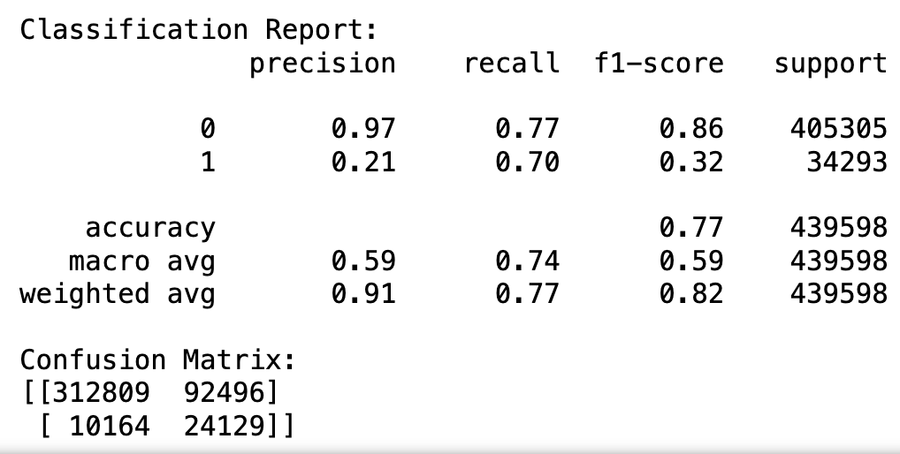
ML Model Building and Model Validation - Light Gradient Boosting
Inference:Better than previous model as Light Gradient Boosting model achieves a precision of 97% for loan approvals, minimizing the risk of granting loans to unqualified applicants.With an weighted Avg F1-score of 82%, the model maintains a good balance between precision and recall, ensuring reliable decision-making in approving loans.The ROC curve area(It's good metrics for imbalanced classes) of 82% demonstrates the model's ability to discriminate between loan approvals and rejections, providing valuable insights for risk assessment.Overall, the model's high precision, balanced F1-score, effective discrimination, and stable predictions make it a valuable tool for the bank in identifying qualified borrowers while minimizing risks associated with loan approvals.However there is still further scope to optimise the model specially for Class -1 . we can further do Hyperparameters tuning for Gradient Boosting.

Slide 13
Conclusion and Recommendations
The Final model achieved an accuracy of 76%, indicating its ability to correctly classify loan applications as approved or rejected.With an ROC curve area of 0.82, the model shows a good ability to differentiate between loan approvals and rejections.
Top 10 Factors Influencing Borrower Behavior:
'CREDIT_TERM'
'DEBT_CREDIT_RATIO'
'DAYS_EMPLOYED'
'DAYS_BIRTH'
'TOTAL_DEBT_SUM'
'AMT_GOODS_PRICE'
'AMT_CREDIT'
'DAYS_CREDIT_interval_1-2 years'
'DAYS_CREDIT_interval_3+ years'
'DAYS_CREDIT_interval_<1 year'
Features like 'DEBT_CREDIT_RATIO', ' 'DAYS_CREDIT_interval_*' and 'TOTAL_DEBT_SUM' from the credit bureau data contribute significantly to understanding borrowers' historical credit usage and payment patterns.
Factors such as 'CREDIT_TERM', 'AMT_CREDIT', 'AMT_GOODS_PRICE', DAYS_EMPLOYED significantly influence borrower behavior.
All These features help to understand borrowers' financial health, client age group, and all the risk tendencies by analyzing loan terms, affordability ratios, employment duration, and debt management. Financial institutions can
then use this information to make better decisions about approving loans.

